Slide 1
Image Segmentation
Presentation by:-
Vishal Kumar Vishwakarma
Ravi Kumar

Slide 2
What is Image Processing?
Image processing is a method to perform some operations on an image, in order to get an enhanced image or to extract some useful information from it.
It aims at improving the quality of the image as far as visualization is concerned.
In this our input is original image and output is a processed image.

Slide 3
Image Analysis
Image Segmentation
Different Approches –
Discontinuity Based
Region Based
Different Edge Detection Operators
Linking of Edge Points
Local Processing
Global Processing

Slide 4
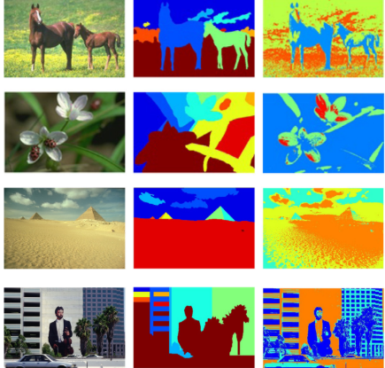
Image Segmentation
A process of subdividing an image into its constituent parts or objects in the image
Aim: Analysing substituent parts or objects once they are divided into objects to extract information.
Conclusion: Information extracted are useful for high level machine vision applications.

Slide 5
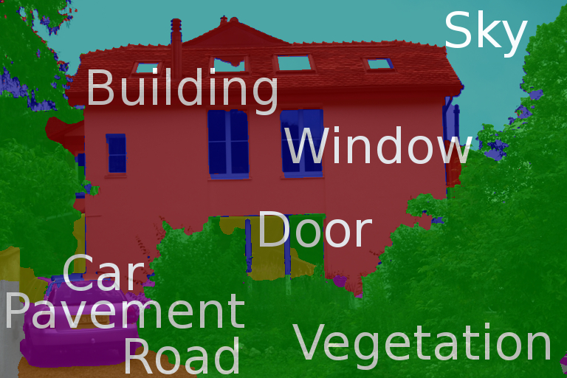
Level of Segmentation
Till what extent the image should be segmented?

Slide 6
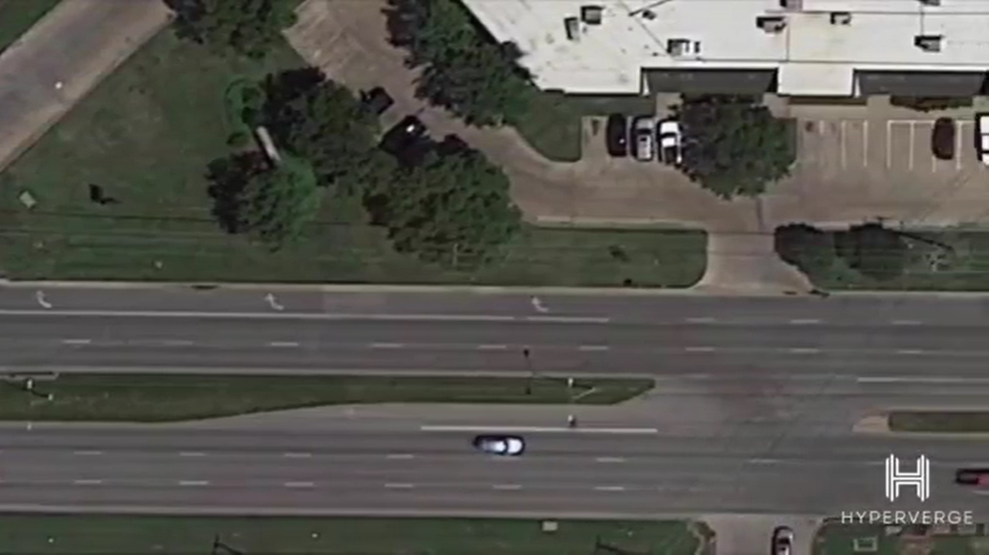
An Example
Detecting the Movement of a Vehicle
To detect movement pattern of different vehicles on Road :Aim
No need of Segmenting this part
(Area of No interest)
We segment this road
Then we segment vehicle

Slide 7
Different Approaches to Image Segmentation
Discontinuity based
Similarity based
Discontinuity Based

Slide 8
Contact Information

